Slide 1
Hateful Meme Detection

Slide 2
Problem Statement
Hate speech and offensive content in the form of memes have become prevalent on various online platforms, posing a significant threat to social harmony and digital well-being.

Slide 3
Abstract
Our project focuses on employing machine learning for the automated detection of hate speech within memes, a prevalent issue in online content.
Our approach involves preprocessing, feature extraction, and model training. We utilize text and image processing techniques to address diverse meme formats and linguistic challenges.
Key features are extracted for effective meme representation using natural language processing and computer vision methods.

Slide 4
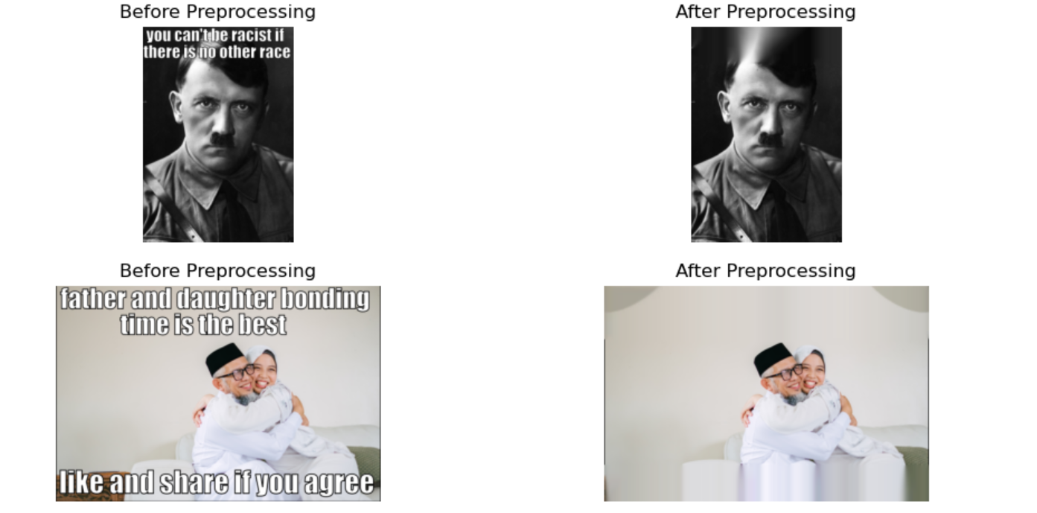
Optical character recognition
Optical character recognition is used to remove text from images.
After extracting text from images both text and images can be used for feature extraction and embeddings.

Slide 5
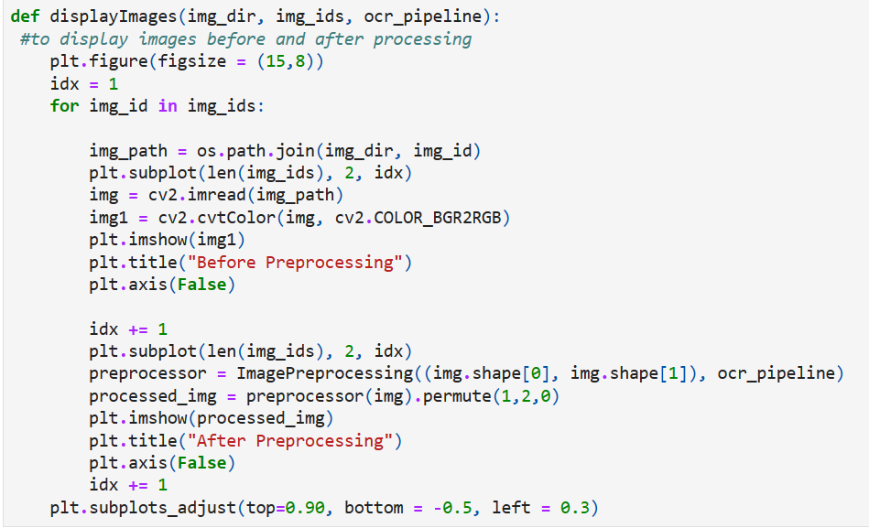
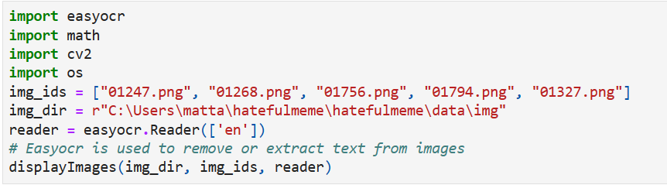
Optical character recognition
Code to display images
Easyocr code

Slide 6
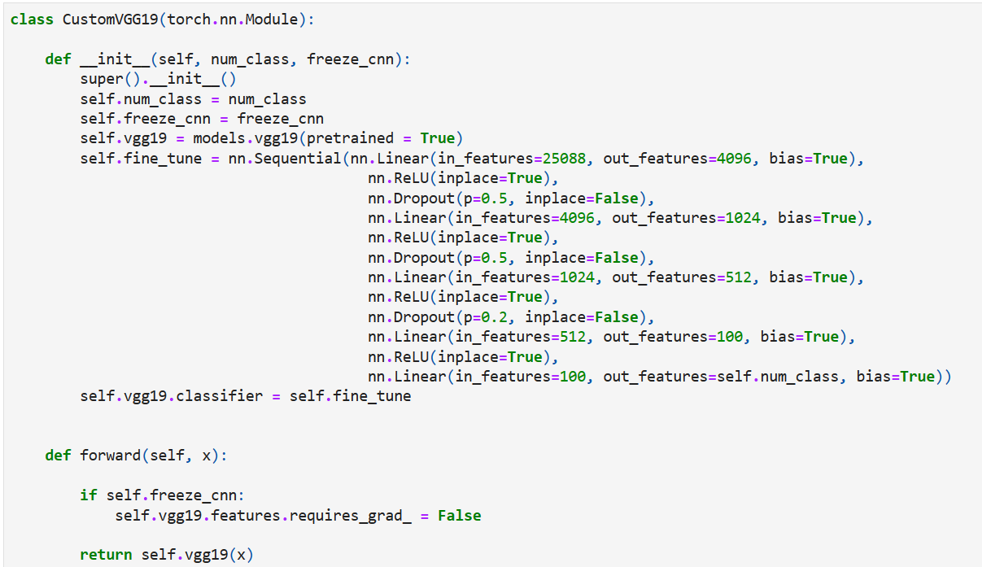
VGG19 Model
The VGGI 9 model is a CNN that can be used for image classification, object detection, and semantics, segmentation.

Slide 7
Embeddings
Embeddings are representations of values or objects like text, images, and audio that are designed to be consumed by machine learning models and semantic search algorithms.
Embeddings make it easier to do machine learning on large inputs like sparse vectors representing words
An embedding can be learned and reused across models.
Jointly embedding diverse data types (e.g. text, images, ...) is also possible.

Slide 8
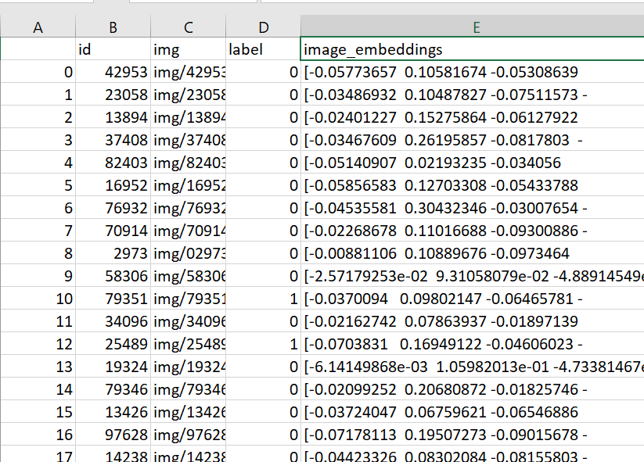
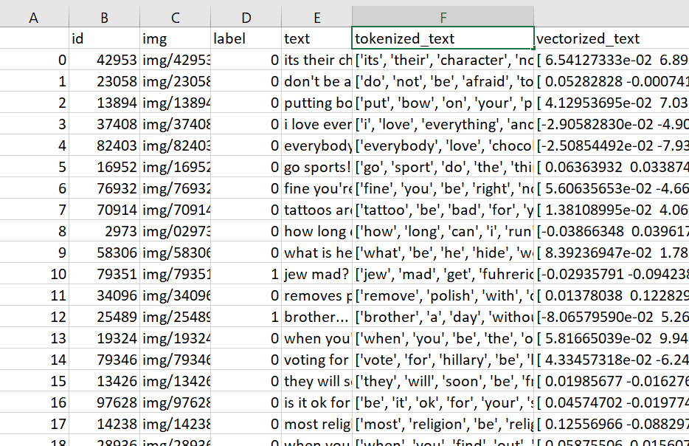
Embeddings
Image Embeddings
Text Embeddings

Slide 9
Thank You

